Slide 1
Divide and Conquer Strategy - Merge Sort & Quick Sort
Lect 14 and 15
The class notes are a compilation and edition from many sources. The faculty does not claim intellectual property or ownership of the lecture notes. Thanks to them!

Slide 2
Sorting
Selection sort
  Design approach:
  Sorts in place:
  Running time:
Merge Sort
  Design approach:
  Sorts in place:
  Running time:
incremental
Yes
Θ(n²)
divide and conquer
No
Let’s see!!

Slide 3
Divide-and-Conquer
Divide the problem into a number of sub-problems
  Similar sub-problems of smaller size
Conquer the sub-problems
  Solve the sub-problems recursively
  Sub-problem size small enough ⇒ solve the problems in straightforward manner
Combine the solutions of the sub-problems
  Obtain the solution for the original problem

Slide 4
Merge Sort Approach
To sort an array A[p . . r]:
Divide
  Divide the n-element sequence to be sorted into two subsequences of n/2 elements each
Conquer
  Sort the subsequences recursively using merge sort
  When the size of the sequences is 1 there is nothing more to do
Combine
  Merge the two sorted subsequences

Slide 5
Merge Sort
p
q
r
1
2
3
4
5
6
7
8
Alg.: MERGE-SORT(A, p, r)
if p < r Check for base case
then q ← ⎣(p + r)/2⎦ Divide
MERGE-SORT(A, p, q) Conquer
MERGE-SORT(A, q + 1, r) Conquer
MERGE(A, p, q, r) Combine
Initial call: MERGE-SORT(A, 1, n)
5
2
4
7
1
3
2
6

Slide 6
Example – n Power of 2
Divide
1
2
3
4
5
6
7
8
5
2
4
7
1
3
2
6
q = 4
1
2
3
4
5
6
7
8
5
2
4
7
1
3
2
6
1
2
3
4
5
6
7
8
5
2
4
7
1
3
2
6
1
2
3
4
5
6
7
8
5
2
4
7
1
3
2
6

Slide 7
Example – n Power of 2
Conquer
and
Merge
1
2
3
4
5
6
7
8
1
2
2
3
4
5
6
7
1
2
3
4
5
6
7
8
2
4
5
7
1
2
3
6
1
2
3
4
5
6
7
8
2
5
4
7
1
3
2
6
1
2
3
4
5
6
7
8
5
2
4
7
1
3
2
6

Slide 8
Example – n Not a Power of 2
1
2
3
4
5
6
7
8
9
10
11
Divide
4
7
2
6
1
4
7
3
5
2
6
q = 6
1
2
3
4
5
6
7
8
9
10
11
q = 3
4
7
2
6
1
4
7
3
5
2
6
q = 9
1
2
3
4
5
6
7
8
9
10
11
4
7
2
6
1
4
7
3
5
2
6
1
2
3
4
5
6
7
8
9
10
11
4
7
2
6
1
4
7
3
5
2
6
1
2
4
5
7
8
4
7
6
1
7
3

Slide 9
Example – n Not a Power of 2
Conquer
and
Merge
1
2
3
4
5
6
7
8
9
10
11
1
2
2
3
4
4
5
6
6
7
7
1
2
3
4
5
6
7
8
9
10
11
1
2
4
4
6
7
2
3
5
6
7
1
2
3
4
5
6
7
8
9
10
11
2
4
7
1
4
6
3
5
7
2
6
1
2
3
4
5
6
7
8
9
10
11
4
7
2
1
6
4
3
7
5
2
6
1
2
4
5
7
8
4
7
6
1
7
3

Slide 10
Merging
p
q
r
1
2
3
4
5
6
7
8
2
4
5
7
1
2
3
6
Input: Array A and indices p, q, r such that p ≤ q < r
  Subarrays A[p . . q] and A[q + 1 . . r] are sorted
Output: One single sorted subarray A[p . . r]

Slide 11
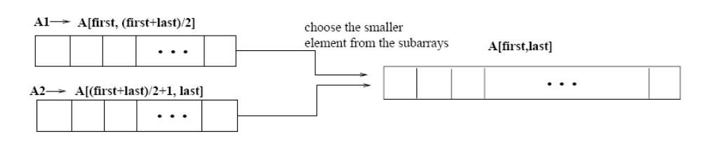
Merging
p
q
r
Idea for merging:
  Two piles of sorted cards
    Choose the smaller of the two top cards
    Remove it and place it in the output pile
  Repeat the process until one pile is empty
  Take the remaining input pile and place it face-down onto the output pile
1
2
3
4
5
6
7
8
2
4
5
7
1
2
3
6
A1← A[p, q]
A[p, r]
A2← A[q+1, r]

Slide 12
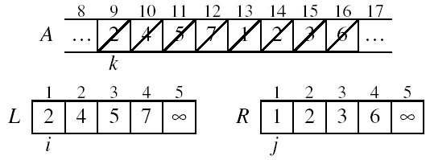
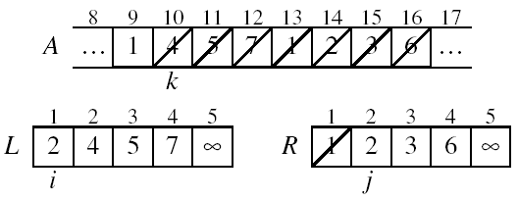
Example: MERGE(A, 9, 12, 16)
p
q
r

Slide 13
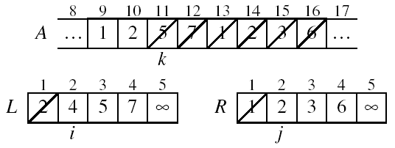
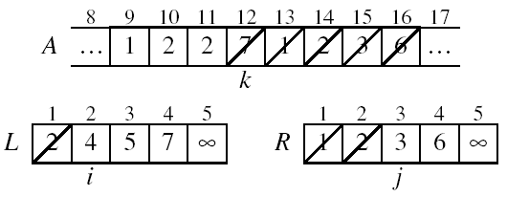
Example: MERGE(A, 9, 12, 16)

Slide 14
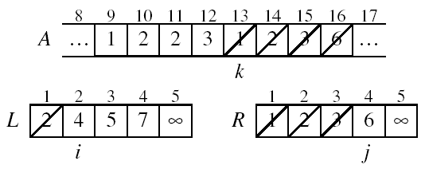
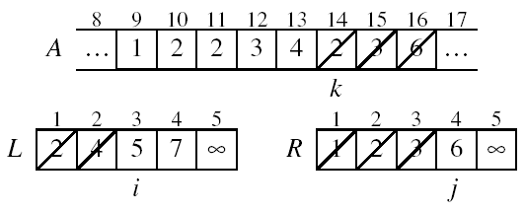
Example (cont.)

Slide 15
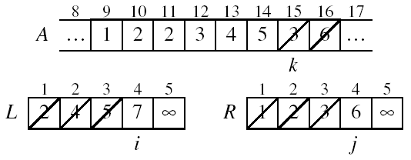
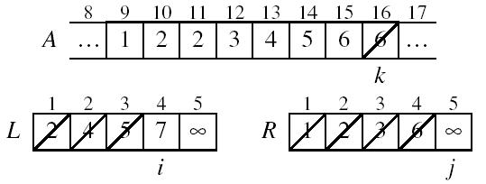
Example (cont.)

Slide 16
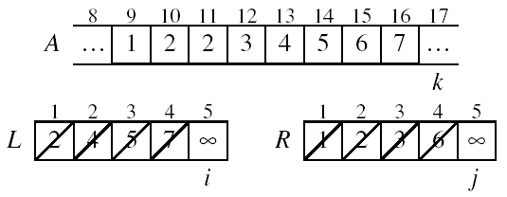
Example (cont.)
Done!

Slide 17
Trace Out
A = 4 9 0 -1 3 7 2 8 9 34 21

Slide 18
Correctness of Merge
Merge(A, p, q, r)
1 n₁ ← q – p + 1
2 n₂ ← r – q
for i ← 1 to n₁
do L[i] ← A[p + i – 1]
for j ← 1 to n₂
do R[j] ← A[q + j]
L[n₁+1] ← ∞
R[n₂+1] ← ∞
i ← 1
j ← 1
for k ←p to r
do if L[i] ≤ R[j]
then A[k] ← L[i]
i ← i + 1
else A[k] ← R[j]
j ← j + 1
p
q
r
1
2
3
4
5
6
7
8
2
4
5
7
1
2
3
6
n₁
n₂
p
q
L
2
4
5
7
∞
q + 1
r
R
1
2
3
6
∞
Sentinels, to avoid having to
check if either subarray is
fully copied at each step.
Comp 122

Slide 19
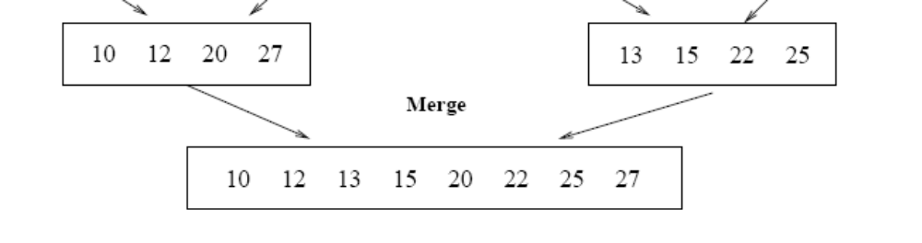
Running Time of Merge
(assume last for loop)
Initialization (copying into temporary arrays):
  Θ(n₁ + n₂) = Θ(n)
Adding the elements to the final array:
  - n iterations, each taking constant time ⇒ Θ(n)
Total time for Merge:
  Θ(n)

Slide 20
Analyzing Divide-and Conquer Algorithms
The recurrence is based on the three steps of the paradigm:
  T(n) – running time on a problem of size n
  Divide the problem into a subproblems, each of size n/b: takes D(n)
  Conquer (solve) the subproblems aT(n/b)
  Combine the solutions C(n)
Θ(1) if n ≤ c
T(n) = aT(n/b) + D(n) + C(n) otherwise

Slide 21
MERGE-SORT Running Time
Divide:
  compute q as the average of p and r: D(n) = Θ(1)
Conquer:
  recursively solve 2 subproblems, each of size n/2 ⇒ 2T (n/2)
Combine:
  MERGE on an n-element subarray takes Θ(n) time ⇒ C(n) = Θ(n)
Θ(1) if n =1
T(n) = 2T(n/2) + Θ(n) if n > 1

Slide 22
Solve Merge Sort Recurrence
Θ(1) if n =1
Solve T(n) = 2T(n/2) + Θ(n) if n > 1
Using Recursion Tree Method
Using Masters Theorem

Slide 23
Recurrence Tree analysis of Merge-Sort
The height h of the merge-sort tree is O(log n)
  at each recursive call we divide in half the sequence,
The overall amount or work done at the nodes of depth i is O(n)
  we partition and merge 2^{i} sequences of size n/2^{i}
  we make 2^{i+1} recursive calls
Thus, the total running time of merge-sort is O(n log n)
depth | #seqs | size
0 | 1 | n
1 | 2 | n/2
i | 2^{i} | n/2^{i}
… | … | …

Slide 24
Recurrence Tree analysis of Merge-Sort
Because we divide the array in half each time, there are log(n) levels
So merge sort is an O(n log(n)) algorithm
  this is a big improvement over the O(n²) sorting algorithms
log(n) levels
O(n) work at each level

Slide 25
Solve the Recurrence
T(n) = c if n = 1
2T(n/2) + cn if n > 1
Use Master’s Theorem:
Compare n with f(n) = cn
Case 2: T(n) = Θ(nlgn)

Slide 26
Merge Sort - Discussion
Running time insensitive of the input
Advantages:
  Guaranteed to run in Θ(nlgn)
Disadvantage
  Requires extra space ≈N

Slide 27
Sorting Challenge 1
Problem: Sort a file of huge records with tiny keys
Example application: Reorganize your MP-3 files
Which method to use?
  merge sort, guaranteed to run in time ∼NlgN
  selection sort
  bubble sort
  a custom algorithm for huge records/tiny keys
  insertion sort

Slide 28
Sorting Files with Huge Records and Small Keys
Insertion sort or bubble sort?
  NO, too many exchanges
Selection sort?
  YES, it takes linear time for exchanges
Merge sort or custom method?
  Probably not: selection sort simpler, does less swaps

Slide 29
Sorting Challenge 2
Problem: Sort a huge randomly-ordered file of small records
Application: Process transaction record for a phone company
Which sorting method to use?
  Bubble sort
  Selection sort
  Mergesort guaranteed to run in time ∼NlgN
  Insertion sort

Slide 30
Sorting Huge, Randomly - Ordered Files
Selection sort?
  NO, always takes quadratic time
Bubble sort?
  NO, quadratic time for randomly-ordered keys
Insertion sort?
  NO, quadratic time for randomly-ordered keys
Mergesort?
  YES, it is designed for this problem

Slide 31
Sorting Challenge 3
Problem: sort a file that is already almost in order
Applications:
  Re-sort a huge database after a few changes
  Doublecheck that someone else sorted a file
Which sorting method to use?
  Mergesort, guaranteed to run in time ∼NlgN
  Selection sort
  Bubble sort
  A custom algorithm for almost in-order files
  Insertion sort

Slide 32
Sorting Files That are Almost in Order
Selection sort?
  NO, always takes quadratic time
Bubble sort?
  NO, bad for some definitions of “almost in order”
  Ex: B C D E F G H I J K L M N O P Q R S T U V W X Y Z A
Insertion sort?
  YES, takes linear time for most definitions of “almost in order”
Mergesort or custom method?
  Probably not: insertion sort simpler and faster

Slide 33
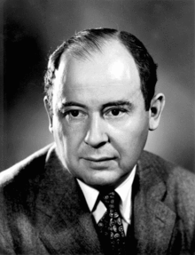
A Legend in CS!
John von Neumann who discovered Mergesort in 1945

Slide 34
Sorting
Assumptions
  No knowledge of the keys or numbers we are sorting on.
  Each key supports a comparison interface or operator.
  Sorting entire records, as opposed to numbers, is an implementation detail.
  Each key is unique (just for convenience).
Comparison Sorting

Slide 35
Comparison Sorting
Given a set of n values, there can be n! permutations of these values.
So if we look at the behavior of the sorting algorithm over all possible n! inputs we can determine the worst-case complexity of the algorithm.

Slide 36

A legend in Computer Science!...
British computer scientist Tony Hoare who discovered Quick Sort in 1959 and published in 1961

Slide 37
An Interview with Hoare!
I suggest you listen to Mr Hoare’s own words of how he came up with the idea for the Quicksort computer sorting algorithm whilst in 1960 Moscow
https://www.bl.uk/voices-of-science/interviewees/tony-hoare/audio/tony-hoare-inventing-quicksort

Slide 38
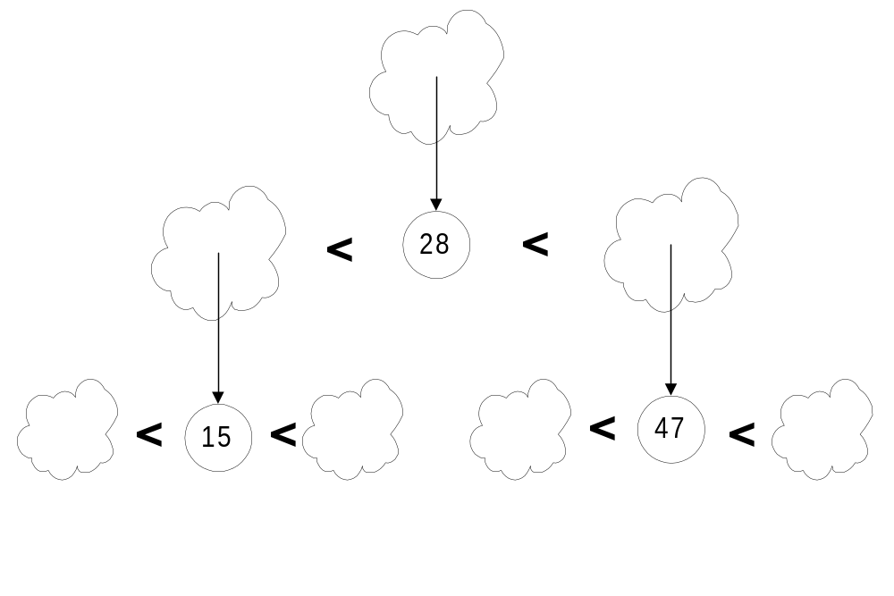
Quick Sort
Pick a “pivot”
Divide into less-than & greater-than pivot
Sort each side recursively

Slide 39
The steps of QuickSort
S
81
31
57
select pivot value
13
43
75
92
0
65
26
S₁
S₂
partition S
0
31
75
13
43
65
92
81
26
57
QuickSort(S₁) and
QuickSort(S₂)
S₁
S₂
0
13
26
31
43
57
65
75
81
92
S
Presto! S is sorted
0
13
26
31
43
57
65
75
81
92
[Weiss]

Slide 40
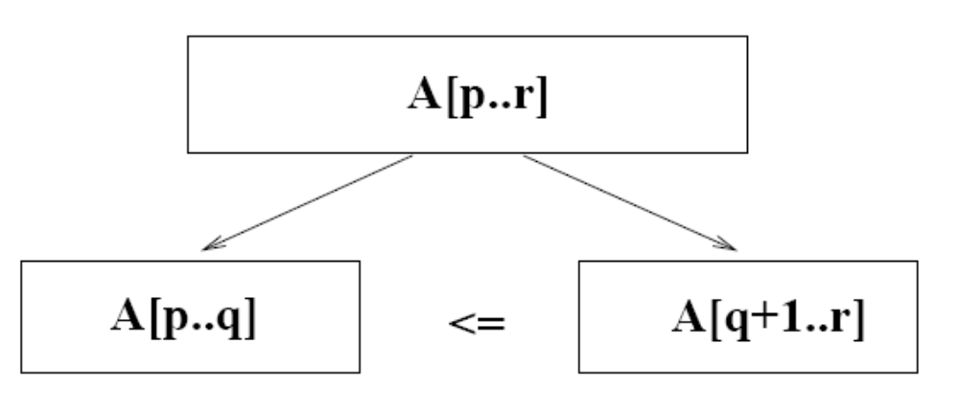
Quicksort
A[p…q]
≤
A[q+1…r]
Sort an array A[p…r]
Divide
  Partition the array A into 2 subarrays A[p..q] and A[q+1..r], such that each element of A[p..q] is smaller than or equal to each element in A[q+1..r]
  Need to find index q to partition the array

Slide 41
Quicksort
A[p…q]
≤
A[q+1…r]
Conquer
  Recursively sort A[p..q] and A[q+1..r] using Quicksort
Combine
  Trivial: the arrays are sorted in place
  No additional work is required to combine them
  The entire array is now sorted

Slide 42
QUICKSORT
Alg.: QUICKSORT(A, p, r)
if p < r
then q ← PARTITION(A, p, r)
QUICKSORT (A, p, q)
QUICKSORT (A, q+1, r)
Initially: p=1, r=n
Recurrence:
T(n) = T(q) + T(n – q) + f(n)
PARTITION())

Slide 43
Partitioning the Array
Choosing PARTITION()
  There are different ways to do this
  Each has its own advantages/disadvantages
Hoare partition
  Select a pivot element x around which to partition
  Grows two regions
A[p…i] ≤ x
x ≤ A[j…r]
A[p…i] ≤ x
x ≤ A[j…r]
i
j

Slide 44
Example 1
i
p
j
5
1
3
9
7
0
4
2
6
8
i
j
5
1
3
9
7
0
4
2
6
8
i
j
5
1
3
9
7
0
4
2
6
8
i
j
5
1
3
2
7
0
4
9
6
8
Move i to the right to be larger than pivot.
Move j to the left to be smaller than pivot.
Swap

Slide 45
Example 1
i
j
5
1
3
2
7
0
4
9
6
8
i
j
5
1
3
2
7
0
4
9
6
8
i
j
5
1
3
2
4
0
7
9
6
8
i
j
5
1
3
2
4
0
7
9
6
8
j
i
5
1
3
2
4
0
7
9
6
8
j
i
0
1
3
2
4
5
7
9
6
8
S₁ < pivot
pivot
S₂ > pivot

Slide 46
Example 2
A[p…r]
pivot x=5
5
3
2
6
4
1
3
7
5
3
2
6
4
1
3
7
i
j
i
j
3
3
2
6
4
1
5
7
3
3
2
6
4
1
5
7
i
j
i
j
A[p…q]
A[q+1…r]
3
3
2
1
4
6
5
7
3
3
2
1
4
6
5
7
i
j
j
i

Slide 47
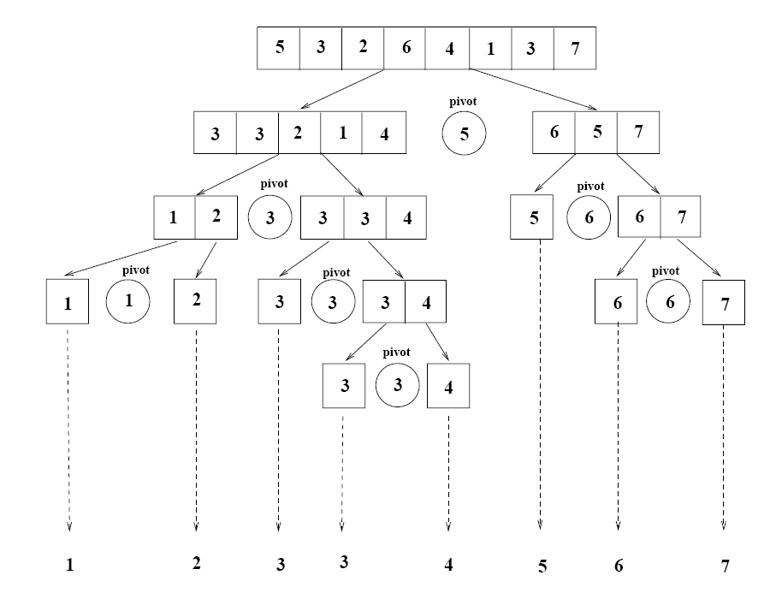
Example 2

Slide 48
Partitioning the Array
Alg. PARTITION (A, p, r)
x ← A[p]
i ← p – 1
j ← r + 1
while TRUE
do repeat j ← j – 1
until A[j] ≤ x
do repeat i ← i + 1
until A[i] ≥ x
if i < j
then exchange A[i] ↔ A[j]
else return j
p
r
A:
5
3
2
6
4
1
3
7
i
j
A[p…q]
≤
A[q+1…r]
A:
a_{p}
a_{r}
j=q
i
Each element is
visited once!
Running time: Θ(n)
n = r – p + 1

Slide 49
Recurrence
Alg.: QUICKSORT(A, p, r)
if p < r
then q ← PARTITION(A, p, r)
QUICKSORT (A, p, q)
QUICKSORT (A, q+1, r)
Initially: p=1, r=n
Recurrence:
T(n) = T(q) + T(n – q) + n

Slide 50
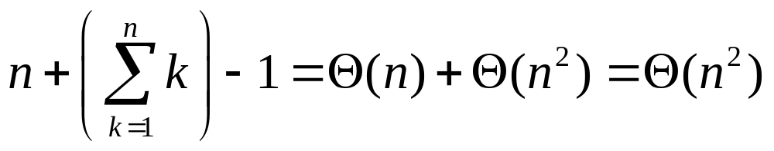
Worst Case Partitioning
Worst-case partitioning
  One region has one element and the other has n – 1 elements
  Maximally unbalanced.. When does this happen?
Recurrence: q=1
  T(n) = T(1) + T(n – 1) + n,
  T(1) = Θ(1)
  T(n) = T(n – 1) + n
  =
n
n
1
n - 1
n
1
n - 2
n - 1
n
1
n - 3
n - 2
1
2
3
1
1
2
Θ(n²)
When does the worst case happen?

Slide 51
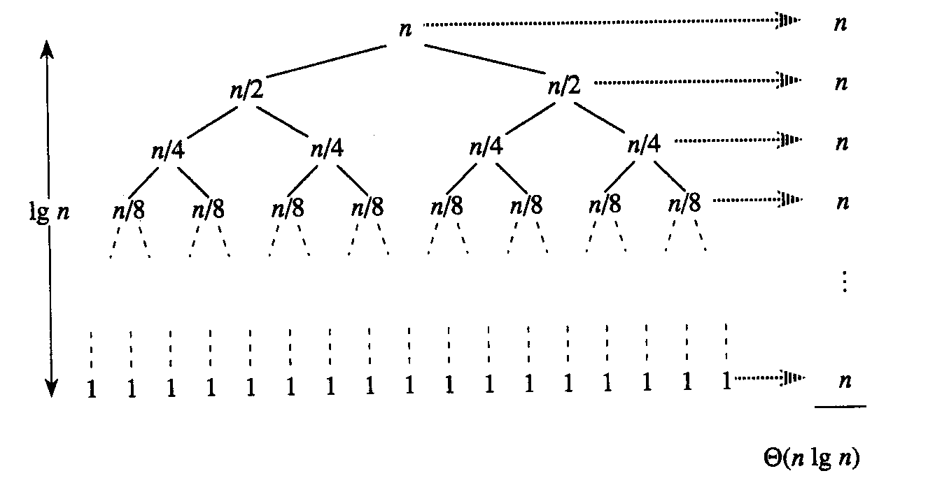
Best Case Partitioning
Best-case partitioning
  Partitioning produces two regions of size n/2
Recurrence: q=n/2
  T(n) = 2T(n/2) + Θ(n)
  T(n) = Θ(nlgn) (Master theorem)

Slide 52
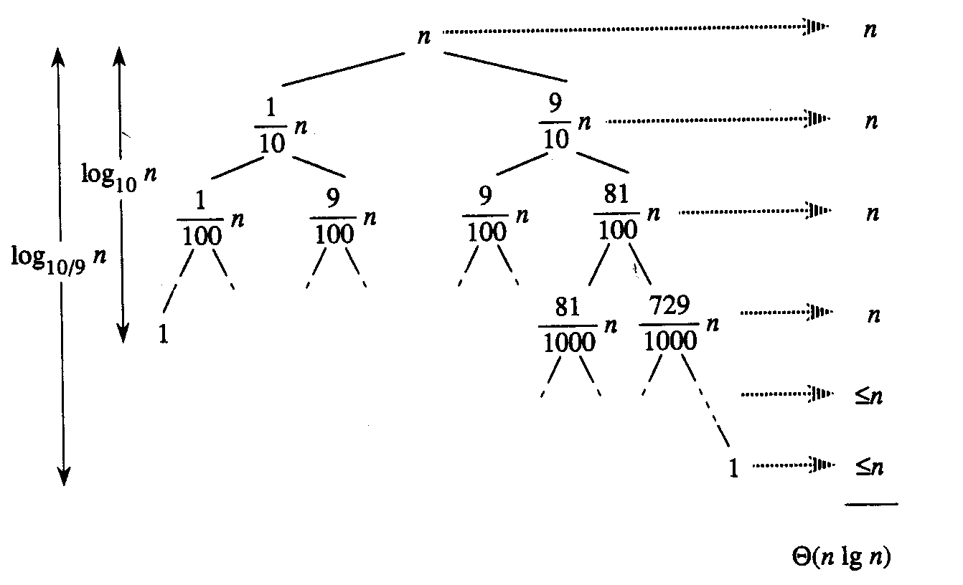
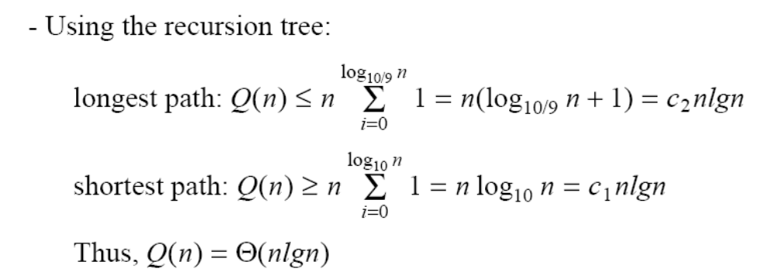
Case Between Worst and Best
9-to-1 proportional split
Q(n) = Q(9n/10) + Q(n/10) + n

Slide 53
Performance of Quicksort
Average case
  All permutations of the input numbers are equally likely
  On a random input array, we will have a mix of well balanced and unbalanced splits
  Good and bad splits are randomly distributed across throughout the tree
partitioning cost:
n = Θ(n)
n
combined partitioning cost:
2n-1 = Θ(n)
n
1
n - 1
(n – 1)/2 + 1
(n – 1)/2
(n – 1)/2
(n – 1)/2
Alternate of a good
and a bad split
Nearly well
balanced split
Running time of Quicksort when levels alternate between good and bad splits is O(nlgn)

Slide 54
Picking the Pivot
There are several ways to pick a pivot.
Objective: Choose a pivot so that we will get 2 partitions of (almost) equal size.

Slide 55
Picking the Pivot (2)
Use the first element as pivot
  if the input is random, ok.
  if the input is presorted (or in reverse order)
    all the elements go into S₂ (or S₁).
    this happens consistently throughout the recursive calls.
    results in O(N²) behavior (we analyze this case later).
Choose the pivot randomly
  generally safe,
  but random number generation can be expensive and does not reduce the running time of the algorithm.

Slide 56
Picking the Pivot (3)
Use the median of the array (ideal pivot)
  The ⎡N/2⎤ th largest element
  Partitioning always cuts the array into roughly half
  An optimal quick sort (O(N log N))
  However, hard to find the exact median
Median-of-three partitioning
  eliminates the bad case for sorted input.
  reduces the number of comparisons by 14%.

Slide 57
Typical case for quicksort
If the array is sorted to begin with, Quicksort is terrible: O(n²)
It is possible to construct other bad cases
However, Quicksort is usually O(n log₂n)
The constants are so good that Quicksort is generally the faster algorithm.
Most real-world sorting is done by Quicksort

Slide 58
Small Arrays
For very small arrays, quick sort does not perform as well as insertion sort
Do not use quick sort recursively for small arrays
  Use a sorting algorithm that is efficient for small arrays, such as insertion sort.
When using quick sort recursively, switch to insertion sort when the sub-arrays have between 5 to 20 elements (10 is usually good).
  saves about 15% in the running time.
  avoids taking the median of three when the sub-array has only 1 or 2 elements.

Slide 59
Quick sort vs. Merge sort
Quick sort:
  pick a pivot value from the array
  partition the list around the pivot value
  sort the left half
  sort the right half
Merge sort:
  divide a list into two identically sized halves
  sort the left half
  sort the right half
  recombine the sorted halves into a sorted whole

Slide 60
Homework
Assume the pivot is chosen as the middle element of an array: pivot = a[(left+right)/2].
Rewrite the partitioning code and the whole quick sort algorithm.

Slide 61
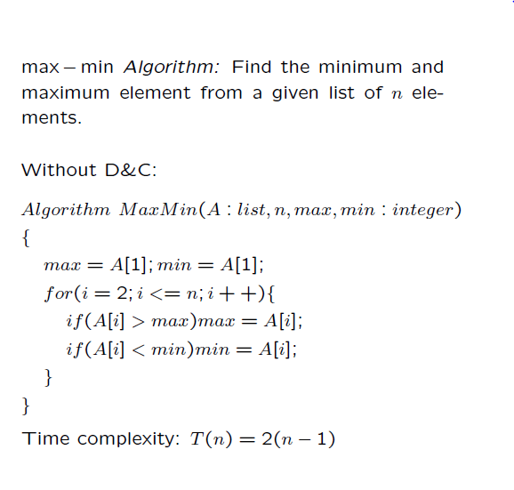
Min-Max Algorithm using Divide and Conquer

Slide 62
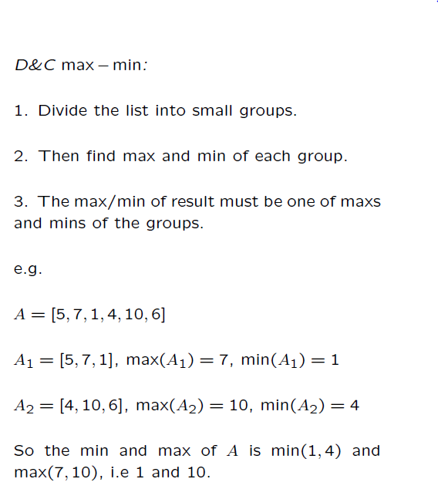

Slide 63
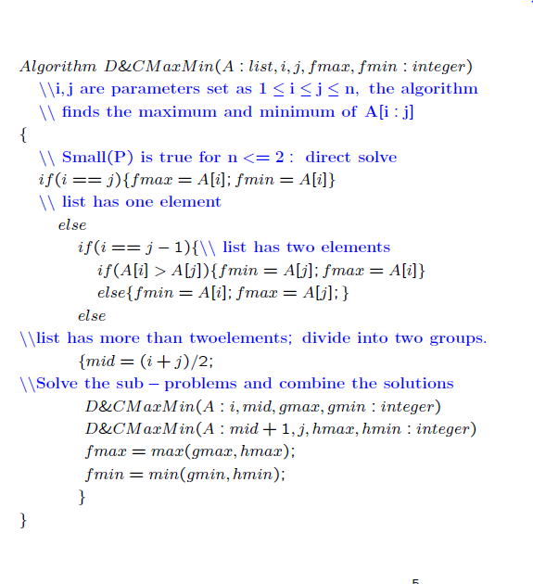

Slide 64
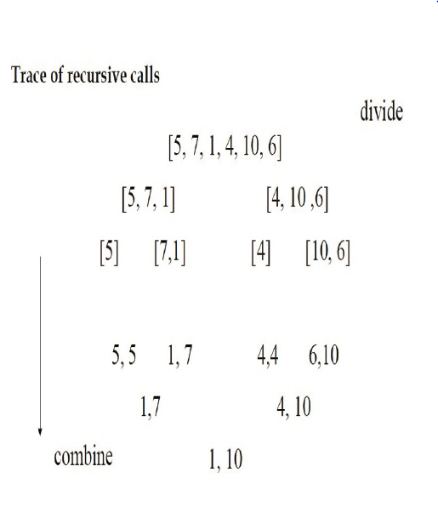

Slide 65
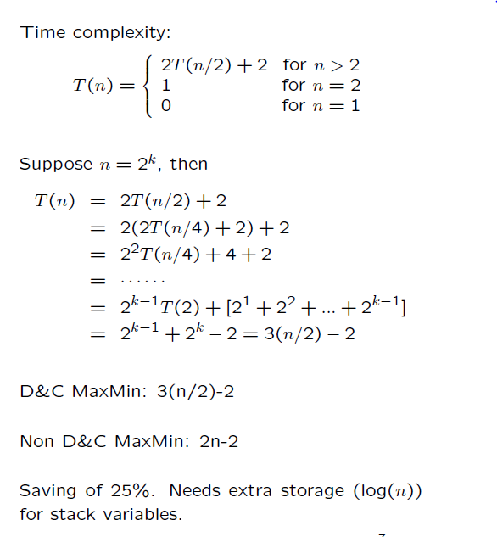

Slide 67
Searching Arrays
Linear search
    small arrays
    unsorted arrays
Binary search
    large arrays
    sorted arrays

Slide 68
Linear Search Algorithm
Start at first element of array.
Compare value to value (key) for which you are searching
Continue with next element of the array until you find a match or reach the last element in the array.
Note: On the average you will have to compare the search key with half the elements in the array.

Slide 69
Linear Search Code
const int arraySize = 100;
int a[arraySize] = {1, 100, 2, 66, 55, 44, 88, 77, 12, 23, 45, 9, 87};
int key = 88;
bool found = false;
for (int i = 0; i < arraySize; i++) {
if (a[i] == key) {
cout << “Found it at array subscript “ << i << endl;
found = true;
break;
}
}
if (! found)
cout << “Could not find element “ << key << “ in array a” << endl;

Slide 70
Binary Search Algorithm
May only be used on a sorted array.
Eliminates one half of the elements after each comparison.
Locate the middle of the array
Compare the value at that location with the search key.
If they are equal - done!
Otherwise, decide which half of the array contains the search key.
Repeat the search on that half of the array and ignore the other half.
The search continues until the key is matched or no elements remain to be searched.

Slide 71
Binary Search Example
a
search key = 19
0
1
2
3
4
5
6
7
8
9
10
11
12
1
low
5
15
19
25
27
29
middle of the array
compare a[6] and 19
19 is smaller than 29 so the next
search will use the lower half of the array
31
33
45
55
88
100
high

Slide 72
Binary Search Pass 2
a
search key = 19
0
1
2
3
4
5
1
low
5
15
use this as the middle of the array
Compare a[2] with 19
15 is smaller than 19 so use the top
half for the next pass
19
25
27
high

Slide 73
Binary Search Pass 3
search key = 19
3
4
5
a
19
low
use this as the middle of the array
Compare a[4] with 19
25 is bigger than 19 so use the bottom
half
25
27
high

Slide 74
Binary Search Pass 4
search key = 19
3
a
low
19
use this as the middle of the array
Compare a[3] with 19
Found!!
high

Slide 75
Binary Search Example
a
search key = 18
0
1
2
3
4
5
6
7
8
9
10
11
12
1
low
5
15
19
25
27
29
middle of the array
compare a[6] and 18
18 is smaller than 29 so the next
search will use the lower half of the array
31
33
45
55
88
100
high

Slide 76
Binary Search Pass 2
a
search key = 18
0
1
2
3
4
5
1
low
5
15
use this as the middle of the array
Compare a[2] with 18
15 is smaller than 18 so use the top
half for the next pass
19
25
27
high

Slide 77
Binary Search Pass 3
search key = 18
3
4
5
a
19
low
use this as the middle of the array
Compare a[4] with 18
25 is bigger than 18 so use the bottom
half
25
27
high

Slide 78
Binary Search Pass 4
search key = 18
3
a
low
19
use this as the middle of the array
Compare a[3] with 18
Does not match and no more elements
to compare.
Not Found!!
high

Slide 79
const int arraySize = 13;
int a[arraySize] = {1, 2, 9, 12, 23, 44, 45, 55, 66, 77, 87, 88, 100 };
int key = 23 , low = 0, middle, high = (arraySize - 1);
while (low <= high) {
middle = (low + high) / 2;
if (key == a[middle]) {
cout << “Found element “ << key << “ at index “ << middle << endl;
break;
}
else if (key < a [middle])
high = middle -1; // search low end of array
else
low = middle + 1; // search high end of array
}

Slide 80
Efficiency
Searching and array of 1024 elements will take at most 10 passes to find a match or determine that the element does not exist in the array.
512, 256, 128, 64, 32, 16, 8, 4, 2, 1
An array of one billion elements takes a maximum of 30 comparisons.
The bigger the array the better a binary search is as compared to a linear search

Slide 81
Complexity Classes
Complexity Class | Name | Example
O(1) | constant time | popping a value off a stack
O(log n) | logarithmic time | binary search on an array
O(n) | linear time | scanning all elements of an array
O(n log n) | log-linear time | binary search on a linked list and good sorting algorithms
O(n²) | quadratic time | poor sorting algorithms (like inserting n items into SortedIntList)
O(n³) | cubic time | (example in lecture 11)
O(2^{n}) | exponential time | Really hard problems. These grow so fast that they’re impractical

Slide 82
Examples of Each Complexity Class’s Growth Rate
  Assume that all complexity classes can process an input of size 100 in 100ms
Input Size (n) | O(1) | O(log n) | O(n) | O(n log n) | O(n²) | O(n³) | O(2^{n})
100 | 100ms | 100ms | 100ms | 100ms | 100ms | 100ms | 100ms
200 | 100ms | 115ms | 200ms | 240ms | 400ms | 800ms | 32.7 sec
400 | 100ms | 130ms | 400ms | 550ms | 1.6 sec | 6.4 sec | 12.4 days
800 | 100ms | 145ms | 800ms | 1.2 sec | 6.4 sec | 51.2 sec | 36.5 million years
1600 | 100ms | 160ms | 1.6 sec | 2.7 sec | 25.6 sec | 6 min 49.6 sec | 4.21 * 10²⁴ years
3200 | 100ms | 175ms | 3.2 sec | 6 sec | 1 min 42.4 sec | 54 min 36 sec | 5.6 * 10⁶¹ years

Slide 83
To Read and watch…
Sorting algos on a nutshell
http://www.iiitdm.ac.in/old/Faculty_Teaching/Sadagopan/pdf/DAA/SortingAlgorithms.pdf
Chapter 2, 4 and 7 of CLRS
Listen to what Cormen is saying about the success of their book
http://www.eecs.mit.edu/news-events/media/introduction-algorithms-best-seller-500000-copies
https://www.youtube.com/watch?v=ywWBy6J5gz8&list=RDlyZQPjUT5B4&index=2
https://www.youtube.com/watch?v=dENca26N6V4&list=RDlyZQPjUT5B4&index=4

